Slide 1

Laddering Momentum Trading Strategy Development Project
Alexander Cheng – 1001634298 – Wednesday, December 21st, 2022

Slide 2
Agenda
Introduction to Momentum Trading
Laddering Risk Management
Python Code
Future Developments

Slide 3
Rotational Momentum Program
Program trades multiple ETFs using a score based on:
Short term momentum
Long term momentum
Short-term volatility
It selects the topmost ETF every holding period. The topmost score is a weighted average of the three scores listed above; more will be explained on how they are calculated
Collects ETFs data from Yahoo finance
Rightmost ETF must be the safest in the list, this allows for certain advanced features of Rotational momentum

Slide 4
Rotational Momentum Parameters
Log returns or percent changes (Log returns will be used in the calculation of portfolio returns)
Aperiods, Lookback period (short term period), typically 20 days
Criteria: Short-term returns (A), long term returns (3x short period, B), and short-term volatility
Frequency is holding period, how long to wait to rebalance (“18-W-FRI”),we will trade every 18 Weeks on Fridays
Delay (1 is instant, 2 for 1 day after)

Slide 5
Rotational Momentum Parameters – Frequency
Frequency represents the holding period, how long to wait to rebalance, 18W-FRI is the Default setting for SPY-TLT combination.
The frequency of a given ETF list can be determined by generating a 3D Sharpe surface, assuming Fridays is the best trading day.
Frequency="B" every business day, "D" every calendar day; "10B" means every 10 business days ("2B" is the minimum)
Frequency="W" every week, "2W" for every 2 weeks, "3W" every 3 weeks etc.
Frequency="W-TUE" every Tuesday, "2W-TUE" for every 2 Tuesdays, "3W-TUE" every 3 Tuesdays etc.
Frequency= "BM" every month, "2BM" for every 2 months, "3BM" every 3 months etc.; B relates to business days; 31 or previous business day if necessary
Frequency="SM" on the middle (15) and end (31) of the month, or previous business day if necessary

Slide 6
Weighted Score Parameters
ShortTermWeight = the weight of short-term returns, .3 by default
LongTermWeight = the weight of long-term returns, .3 by default
ShortTermVolatilityWeight = the weight of short-term volatility, .4
We chose the short-term volatility to have more importance
ShortTermWeight+LongTermWeight+ShortTermVolatilityWeight should add up to 1.

Slide 7
Experimental Parameters
If cash filter set to 1, since ETFs are ordered by risk, choose the last asset, StandsForCash as the SHY, will not include SHY in the rotated ETFs.
When cash filter is triggered, will invest in SHY
Cash Filter is triggered when the price of ETFs selected as best falls below a certain threshold, shown by the moving average periods (MAperiods), ETF must be above 200 moving average to allow for trading (upward trend)
Zboundary = -1.5, an alternative cash filter (but need understand and to uncomment line: alternative cash filter)
Zperiods = 200 , an alternative cash filter (but need understand and to uncomment line: alternative cash filter)
momentum = 1 means A and B returns are ranked in increasing order (momentum), 0 in decreasing order (reversion to the mean)
volmomentum = 1 volatility ranked in increasing order (momentum), 0 in decreasing order (reversion to the mean)

Slide 8
Parameters Selected
logReturns = 0 # Will be using Percent Changes
Aperiods = 20 # Short term lookback period of 20 days – Default, Fridays and Thursdays are the best trading days
ShortTermWeight = .3
LongTermWeight = .3
ShortTermVolatilityWeight = .4
Delay = 1 # Will assume that the trade occurs instantaneously with the signal, technology is improving
Cash filter and other experimental parameters are not used here

Slide 9
Key Parameters
List of ETF’s; stock_list = ["UUP","SPY","TLT","SHY"], we will run using these 4 assets
Lookbacks for longer term period and volatility
Bperiods = 3*Aperiods+((3*Aperiods)//20)*2 #66 Default, formula to calculate longer term period (Look-Back Period)
Speriods = Aperiods #20 Default, volatility measurement follows short term period (Holding Period)

Slide 10
Need for Laddering – Development Project 2
If you know the optimal holding period is 2 weeks, but afraid to hold an ETF position for that long
If you rebalance every week instead of every 2 weeks, momentum performance will be suboptimal
Suppose the program that optimizes the holding period for the momentum trading system tells us our optimal holding period is 15 days, the time it takes for the ETFs to develop their full momentum
Risk Management team tells us that holding a position for 15 days exposes us to too much risk of asset crashing
Want to implement a risk management system by laddering the asset allocation along the time dimension and show its impact on the equity curve volatility.
Doing this will atomize the risk for the ETF’s momentum trading system

Slide 11
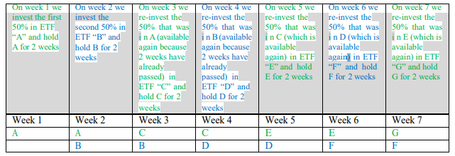
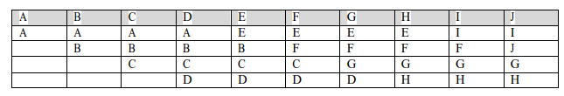
Basic Implementation
Divide the capital in 2 halves (A and B)
Rebalance A on the first week and the third week
Rebalance B on the second and the fourth week
This can be applied to as many weeks / rungs as the holding periods
Optimal Momentum-recommended holding period is 2 weeks, the capital is split into 2 halves for 2 rungs
Optimal Momentum-recommended holding period is 1 month (4 weeks), the capital is split into 4 quarters for 4 rungs

Slide 12
How does the Laddering Risk Management Portfolio work?
Before I had to be fully invested in each security for 2 full weeks to maintain the momentum
Now I can be fully invested in 1 ETF for only 1 week
It is not the same as rebalancing every week since momentum needs at least 2 weeks to build up
Allows for bad ETF exposure reduction without killing the momentum
If an asset crash was to occur, it would only be risking a portion of the invested capital

Slide 13
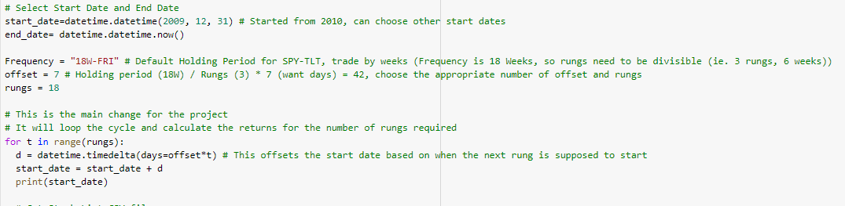
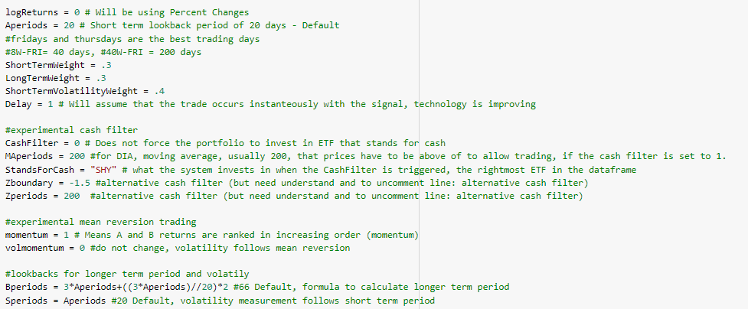
Ladder Rotational Momentum Portfolio Python Code
Our python code will be an adaptation of Lecture 6 – Rotational Momentum Program with Stop Loss (RotationalMomentumWFreqFunc.py)
Input by user: Stock_list based on what stocks to use, Frequency, offset, and rungs Everything else is calculated by the program
Input parameters listed to the right
For loop will iterate for each rung, changing start_date each time

Slide 14
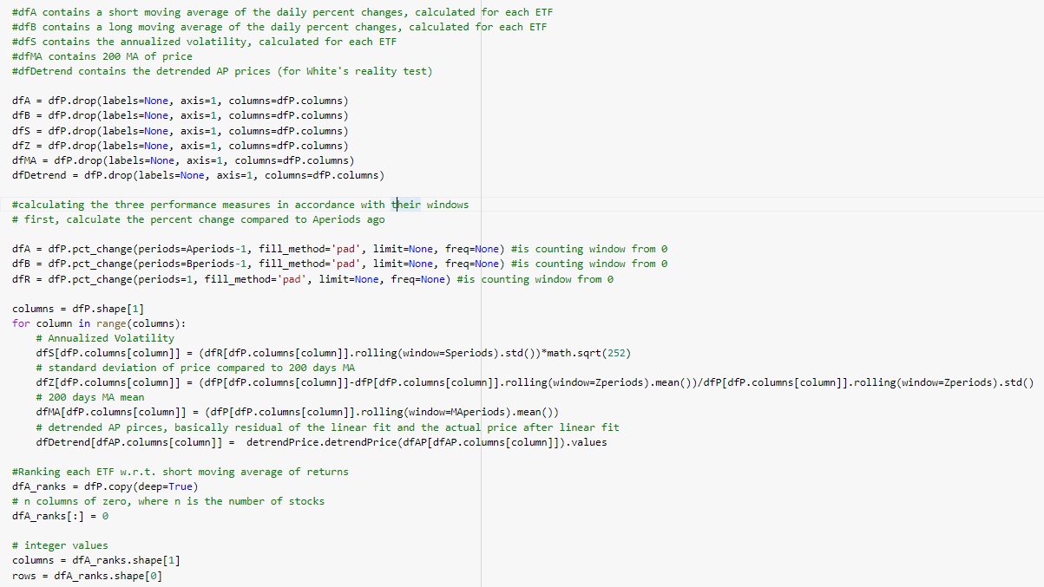
Ladder Rotational Momentum Portfolio Python Code
Looks at historical data to calculate the Annualized Volatility, Standard deviation of price compared to 200 days MA and 200 days MA mean

Slide 15
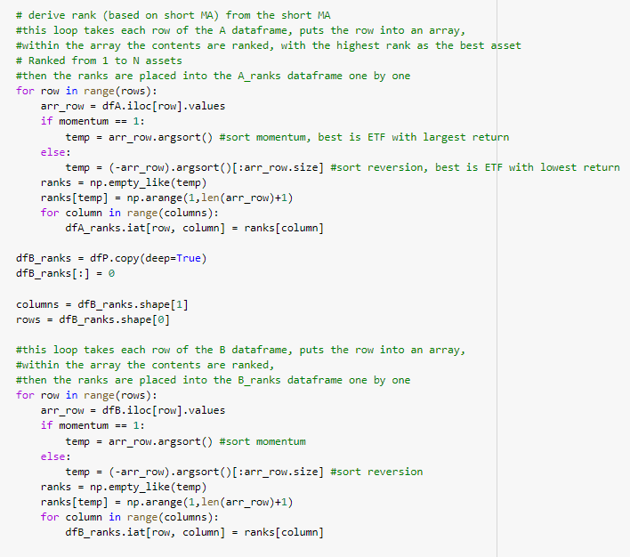
Ranking Score – Python Code
Derive rank (based on short MA) from the short MA, the highest rank as the best asset
Ranked from 1 to N assets
Momentum is used, best assets are those with largest returns
Similarly, the long-term MA and the short-term volatility (best asset is the one with the lowest volatility) are ranked

Slide 16
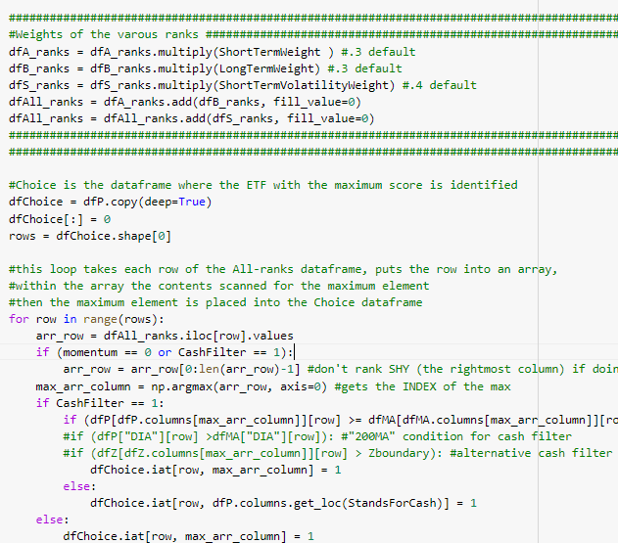
Weighted Score – Python Code
Weights are attached to each score, the weighted average of the scores are added to determine the best asset
It places a value 1 into a new data frame (dfChoice) onto the best ranking asset for each date

Slide 17
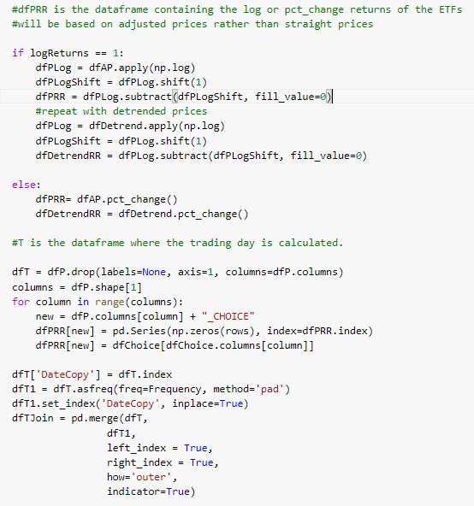
Trading Dates – Python Code
Calculates the detrend price
Creates a dataframe with the trading dates (based on starting date and frequency, the holding period)

Slide 18
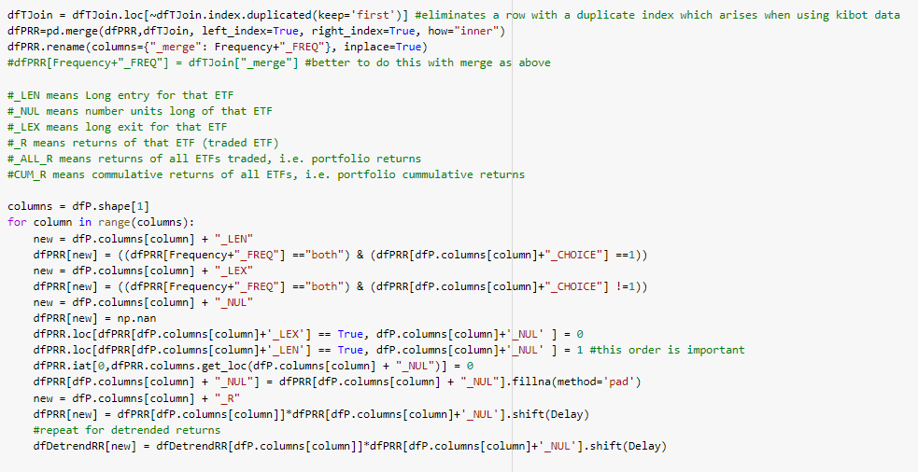
Asset to trade (dfChoice) – Python Code
Determines whether to long entry, long exit, how many units are to be longed based off dfChoice
New returns are calculated for each asset

Slide 19
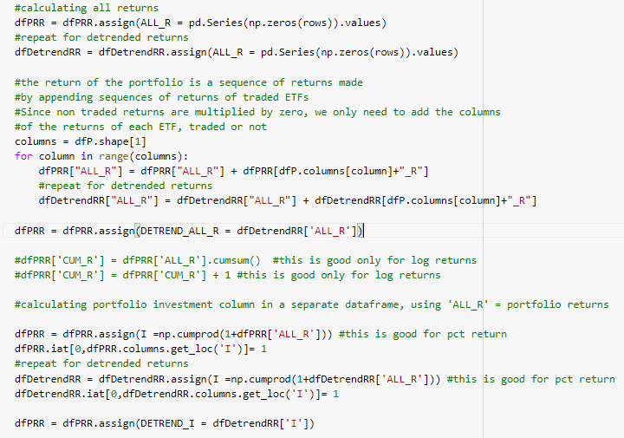
Portfolio Return of a Rung – Python Code
Calculates the portfolio return, the return of the portfolio is a sequence of returns made by appending sequence of returns of traded ETF’s

Slide 20
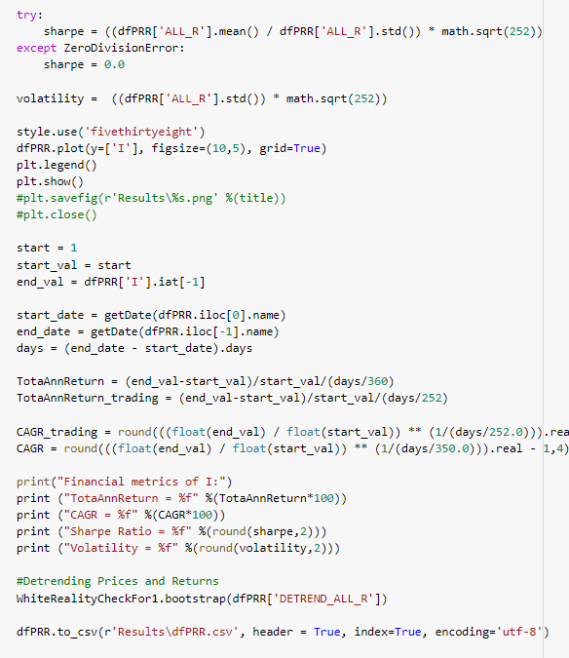
Financial Metrics – Python Code
Calculating the financial metrics of each rung such as the Sharpe ratio, total annual return, CAGR, Volatility, and the White Reality's Check probability
Plots each rung, can visually see which rung is good or bad
Converts the results to a csv file, can open to see which asset is being traded

Slide 21
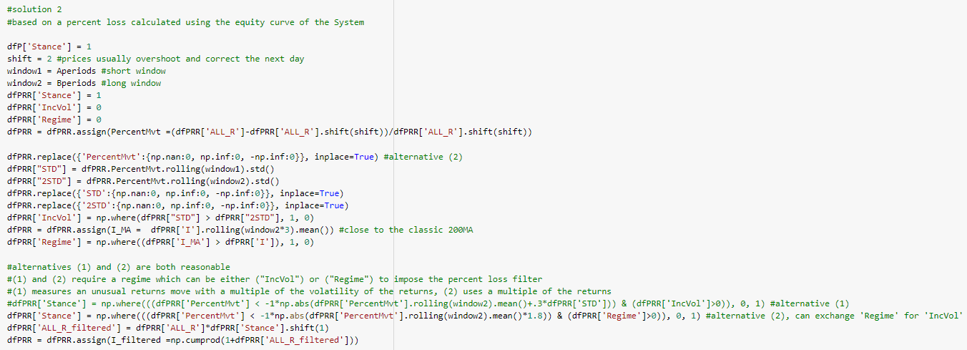
Trailing Stop – Python Code
Trailing Stop Based on the Equity Curve of the System

Slide 22
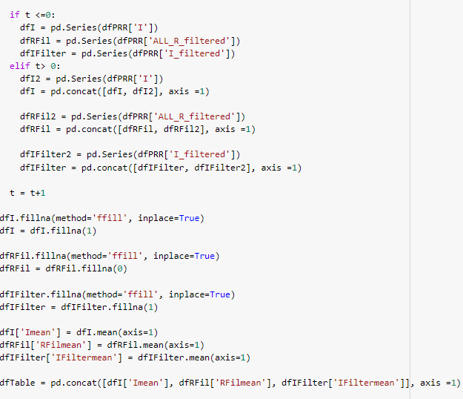
Merging Rungs –Python Code
Created a new dataframe that merges all of the I, R, and I filtered values from each run by filling any missing values and taking the average to represent the overall portfolio with 100% capital

Slide 23
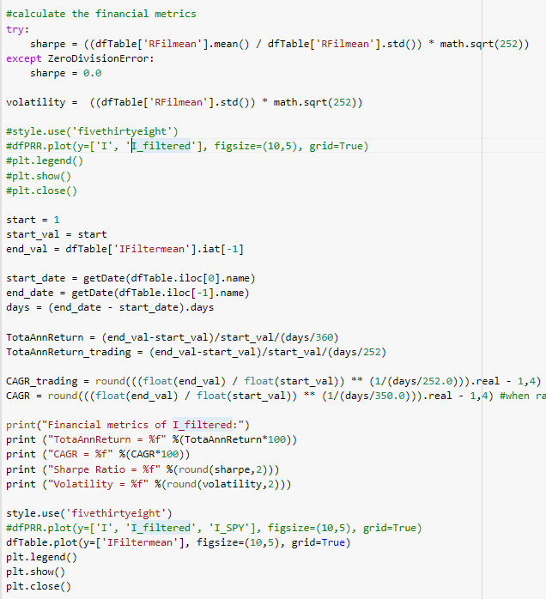
All Rungs Overall Portfolio – Python Code
Calculating the financial metrics of the overall portfolio with all the rungs such as the Sharpe ratio, total annual return, CAGR, Volatility, and the White Reality's Check probability
We can compare the results with different number of rungs

Slide 24
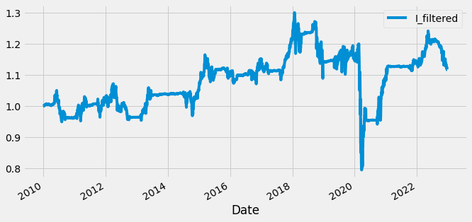
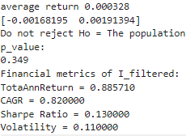
Ladder-Diversifying Portfolio Experiments (1 Rung – No laddering)
This portfolio start-date is the end of December 2009, we can see that this portfolio performs much worse

Slide 25
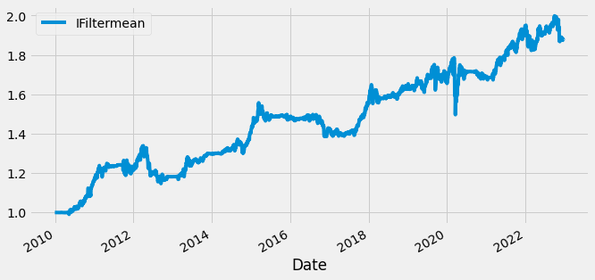
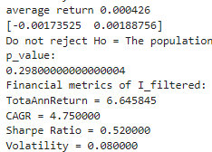
Ladder-Diversifying Portfolio Experiments (3 Rungs)
Using Excel to merge the three rungs individually and then using Python to confirm it was merged correctly
Can observe that implementing this improved the returns

Slide 26
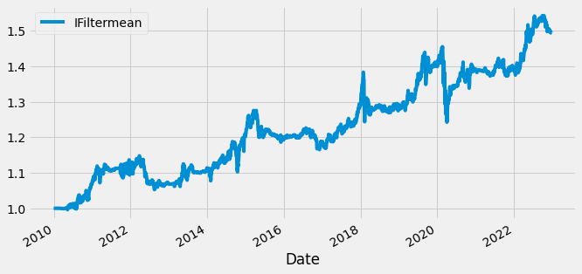
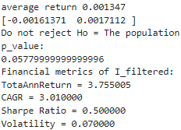
Ladder-Diversifying Portfolio Experiments (6 Rungs)
We see that this does better than the 1 rung and worse than the 3 rung. Now this has less investment capital in a large asset return

Slide 27
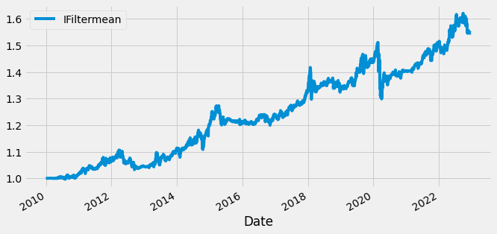
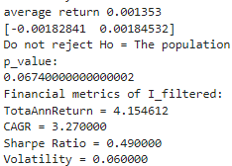
Ladder-Diversifying Portfolio Experiments (18 Rungs)
We invest 1/18 of our investment capital every week, this slightly does better than the 6 rung

Slide 28
Conclusions
We can observe that by laddering our assets when using the momentum rotational program, we can reduce the volatility and increase the expected returns
From our observations, we see that more rungs doesn’t necessarily mean more returns, this may be since this would have less investment capital to capitalize in a large asset return
We do see the volatility decrease as we add more rungs

Slide 29
Future Developments
If I was working in a group and had more time:
We can improve this model by optimizing the holding period, lookback period, and the day of trading using the 3D Sharpe Surface program
We can optimize the weights assigned for short-term, long-term returns, and short-term volatility
Can incorporate the v-ratio to determine the strength of the trend and recalculate the score assigned to the assets
Adapt the rotational momentum program to trade automatically and independently of a bond ETF and a stock ETF, integrating all the equity curves as a weighted average, client can choose how aggressive to invest
Can look at different classifying scores and other risk management strategies

Slide 30

Thank you
Alexander Cheng – 1001634298
Alexand.cheng@mail.utoronto.ca

